Slide 1

CPS Human Automation Interaction Study
Thank you for your interest to participate in this study.
If you encounter any technical difficulties, please make note of the issue and describe your experience in the survey at the end.
We greatly appreciate your feedback.
Press Next to continue

Slide 2
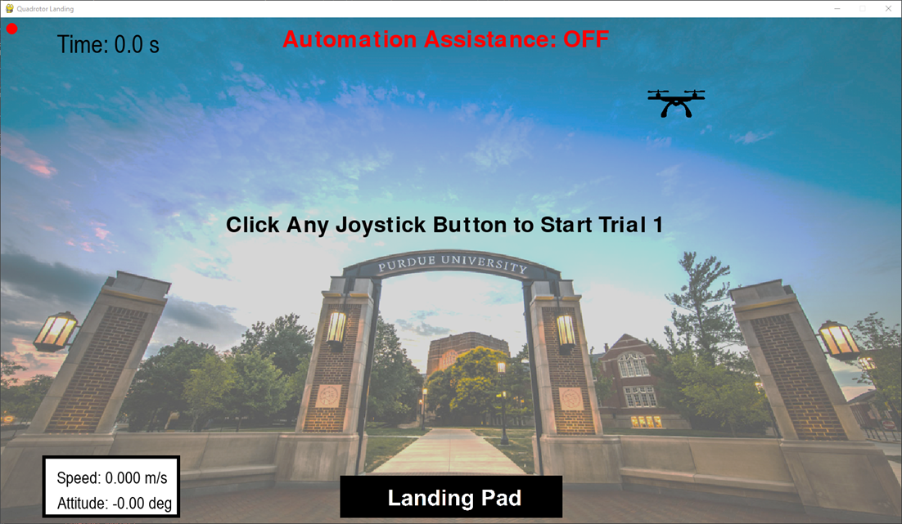

INSTRUCTIONS
You will be interacting with a simulated training module to learn how to land a quadrotor.

Slide 3
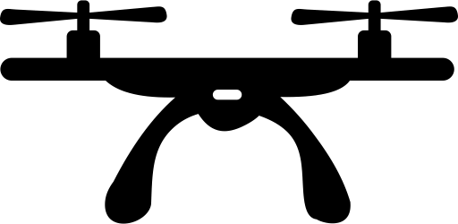
INSTRUCTIONS
The goal is to fly the quadrotor from the starting point to the landing pad.
Starting Point

Slide 4
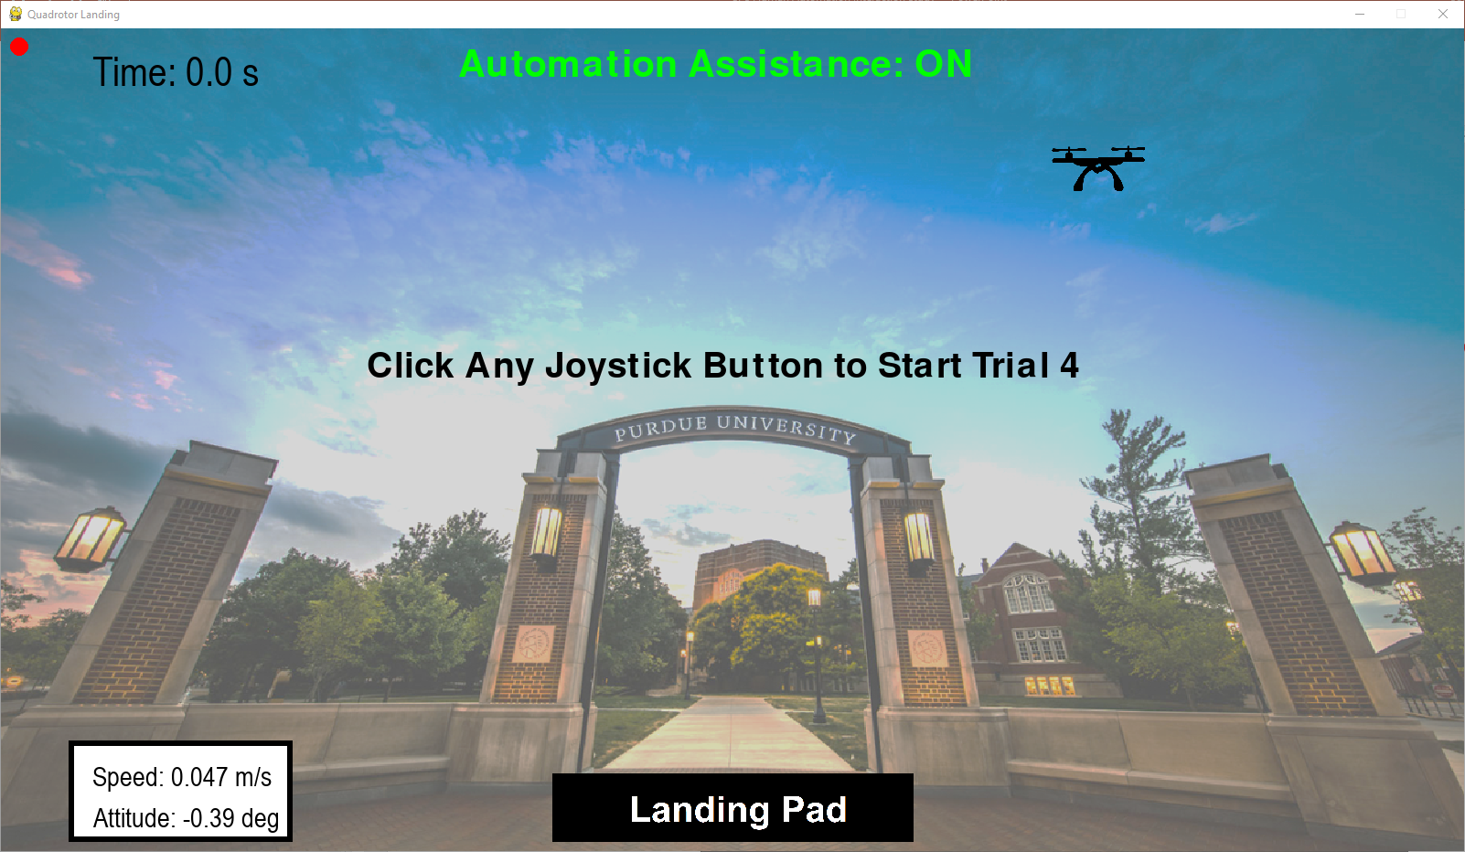
INSTRUCTIONS
To help you improve your ability to land the quadrotor, you may be assisted by an autonomous agent during some trials.

Slide 5
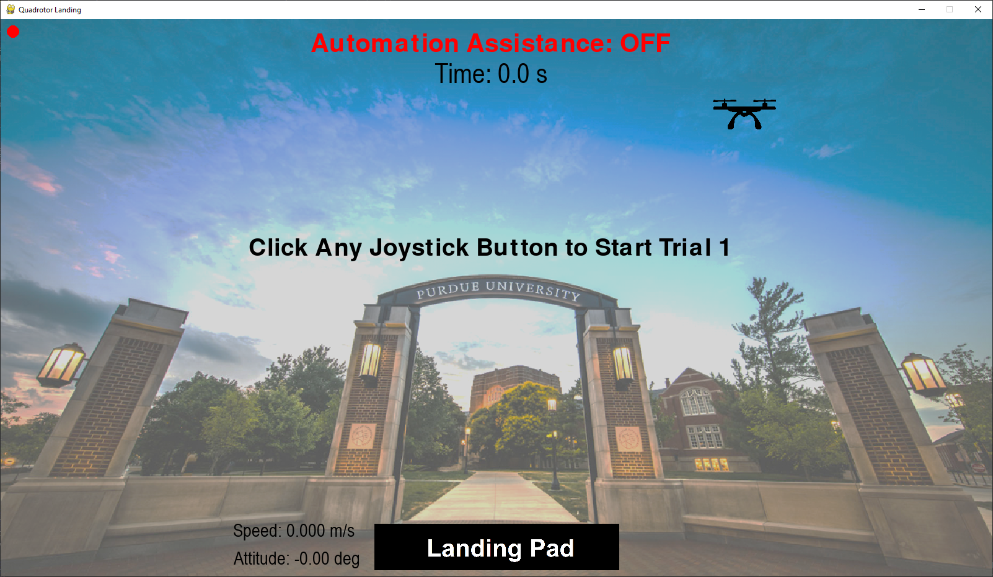
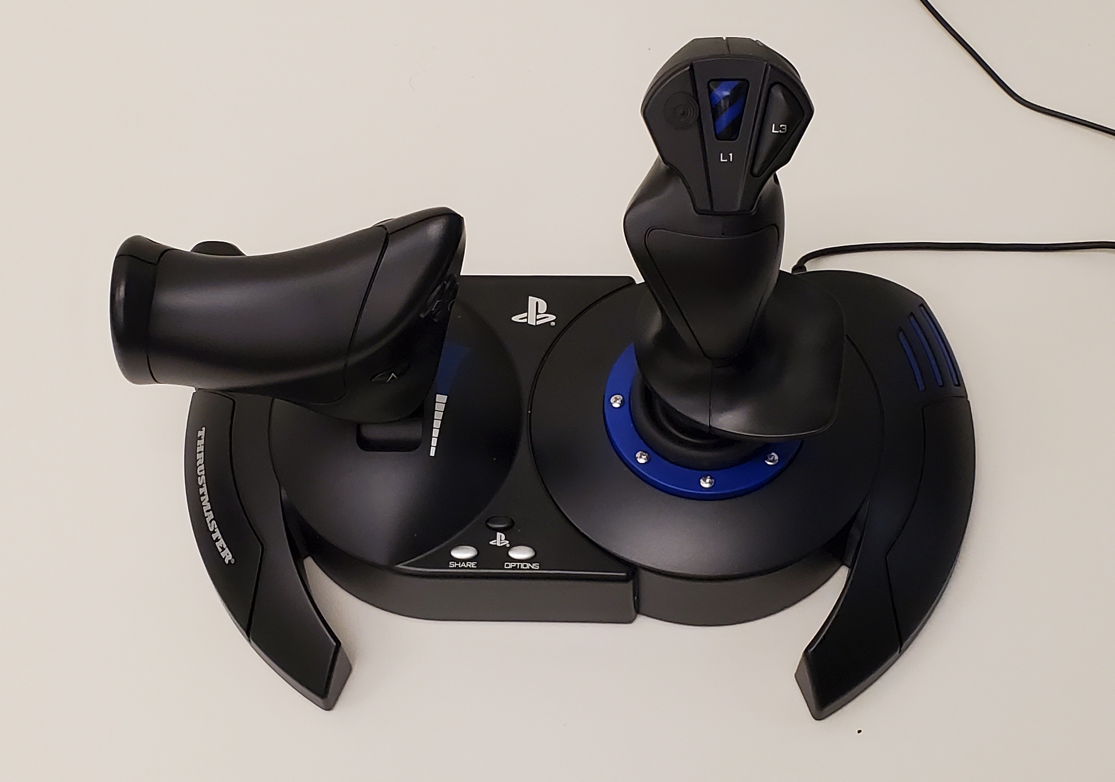
INSTRUCTIONS
You will control the quadrotor’s thrust force and attitude (tilt angle) using the provided joystick and throttle.
Throttle controls Thrust Force
Joystick controls attitude
(Tilt Angle)

Slide 6
INSTRUCTIONS
Tilting the throttle upwards increases thrust force, causing the quadrotor to accelerate.
Tilting the throttle downwards decreases thrust force, causing the quadrotor to decelerate.
If the thrust force is near zero, then gravity is the only force acting on the quadrotor.
Throttle

Slide 7
INSTRUCTIONS
Tilting the joystick to the right causes the quadrotor to rotate clockwise.
Tilting the joystick to the left causes the quadrotor to rotate counter-clockwise.
Joystick

Slide 8
INSTRUCTIONS
In order to safely land the quadrotor, the quadrotor has to land on the landing pad at a speed below 5.0 m/s and attitude (tilt angle) within ±10°. This is categorized as a safe landing. If the quadrotor lands on the landing pad outside of the safe landing criteria, the landing will be categorized as an unsafe landing.

Slide 9
INSTRUCTIONS
If the quadrotor hits the window bounds, the quadrotor will crash. This is categorized as an unsuccessful landing.

Slide 10
INSTRUCTIONS
For your reference, live speed and attitude data is provided on the bottom of the screen.

Slide 11
INSTRUCTIONS
Time is provided at the top of the window. You have 2 minutes to land the quadrotor before the battery dies.

Slide 12
INSTRUCTIONS
The control mode changes depending on whether or not you are receiving assistance from the automation or not. The algorithm will automatically choose the control mode you use to land the drone. In manual control mode, you are controlling the quadrotor without assistance from the automation. In shared control mode, you are controlling the quadrotor with some assistance from the automation.

Slide 13
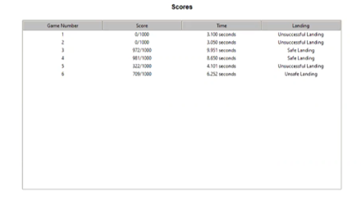
INSTRUCTIONS
After every trial you will receive a score out of 1000. The score is based on how well you land the quadrotor (e.g. speed, attitude, position, time).

Slide 14
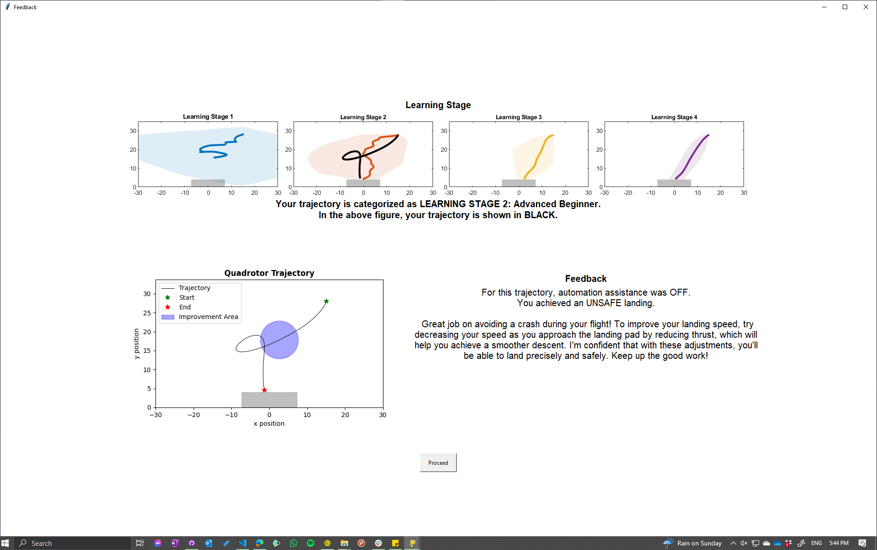
INSTRUCTIONS
You will also receive feedback after each trial.

Slide 15
INSTRUCTIONS
Your most recent trial will be categorized into learning stages 1: Novice, 2: Advanced Beginner, 3: Competent, and 4: Proficient. The figure below represents area the trajectory will most likely be in for each learning stage. The colored lines represent the average position trajectory for each learning stage.

Slide 16
INSTRUCTIONS
You will also be provided a closer look at your previous trial, including an improvement area when deemed necessary.

Slide 17
INSTRUCTIONS
More in depth feedback will be provided for further guidance.

Slide 18
INSTRUCTIONS
You will complete the simulation a total of 15 times. In the first 2 trials, you will land the quadrotor using manual mode. You will then complete 10 additional trials during which the operation mode (manual or shared control) will change based on a pre-specified algorithm. The last 3 trials will be in manual mode.
To start each trial, press any button on the controller.
Each time you complete a trial, you will be asked to fill out a survey.
Press Next to start the practice rounds.
End of instructions

